Slide 1
Evidence for Evolution
Year 10 Pre-ATAR Science

Slide 2
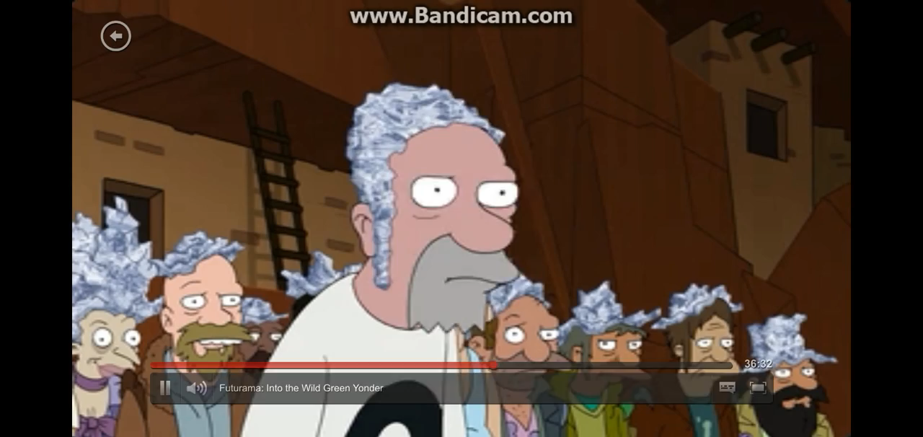

Slide 3
Review
Natural selection leads to change. It relies on variation, more individuals being born than will survive, selection pressures from the environment and survival of the fittest.
Evolution is when change results in so much change that new species develop.

Slide 4
Learning Intention
evaluating and interpreting evidence for evolution, including the fossil record, chemical and anatomical similarities, and geographical distribution of species

Slide 5
Success criteria
List the main groups of evidence for evolution
Give an example of each
Identify similarities and differences between archaeopteryx, dinosaur and modern bird
Compare embryos from mammals, reptiles, birds and amphibians
Explain the difference between homologous and vestigial structures
Identify molecules that may be used for comparative biochemistry
Interpret a cladogram to determine how closely related species are and their common ancestry
Give one example of human evolution in the modern age

Slide 6
Key terms
fossil evidence
archaeopteryx
raptor
embryology
comparative anatomy
homologous structure
vestigial structure
biochemistry
cladogram

Slide 7
Evidence for evolution
1: The fossil record

Slide 8
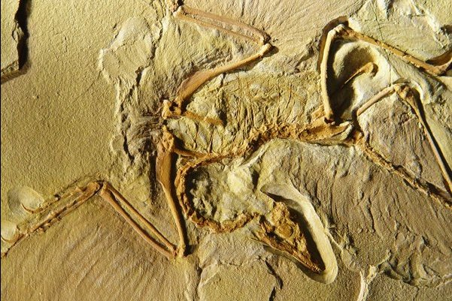
Archaeopteryx

Slide 9
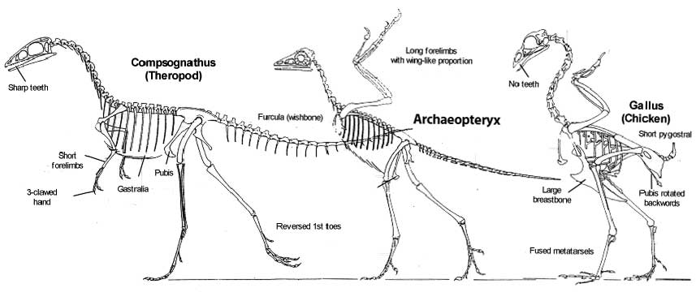

Slide 10


Slide 11
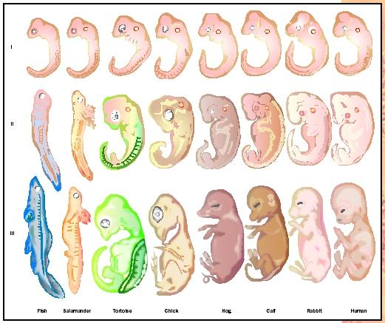
2: Embryology

Slide 12
3: Comparative anatomy
Includes homologous structures and vestigial structures.

Slide 13
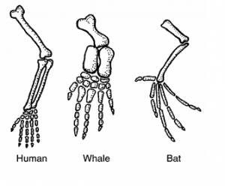
Homologous structures

Slide 14
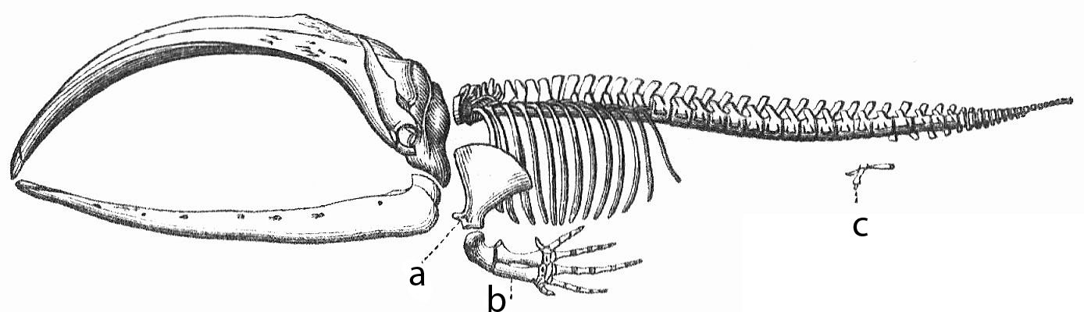
Vestigial structures

Slide 15
4: Comparative biochemistry
Comparing similarities in either nuclear DNA, mitochondrial DNA or other biological molecules, such as enzymes or hormones

Slide 16
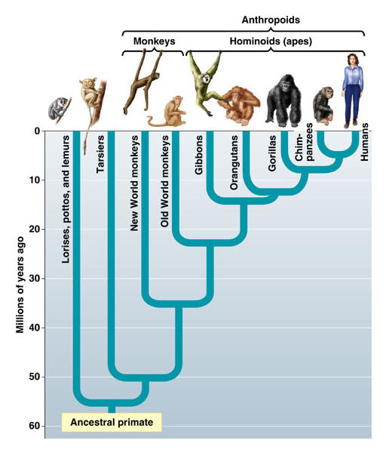

Slide 17
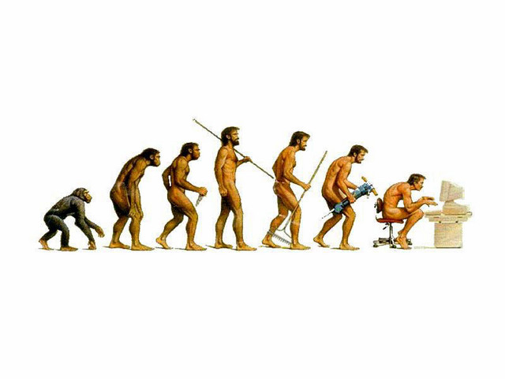
Are humans evolving?

Slide 18


Slide 19
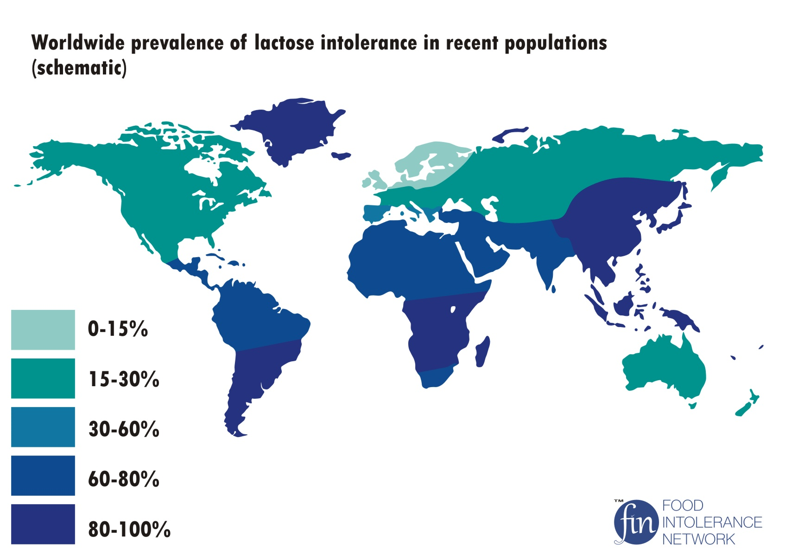

Slide 20
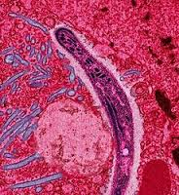
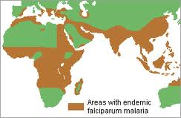
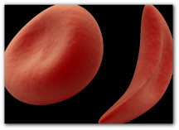
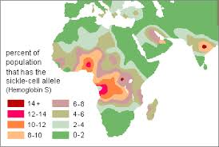

Slide 21
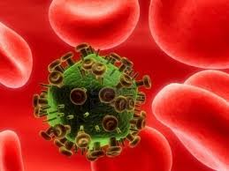

Slide 22


Slide 23
Success criteria
List the main groups of evidence for evolution
Give an example of each
Identify similarities and differences between archaeopteryx, dinosaur and modern bird
Compare embryos from mammals, reptiles, birds and amphibians
Explain the difference between homologous and vestigial structures
Identify molecules that may be used for comparative biochemistry
Interpret a cladogram to determine how closely related species are and their common ancestry
Give one example of human evolution in the modern age

Slide 24


